Slide 1

OS-Climate Data Exchange A Marketplace for the World’s Climate Data Making Climate Data Easy to Find, Consume, Trust, and Share
Screen Shots (Preliminary, Draft)
Eric Broda
May 9, 2023

Slide 2
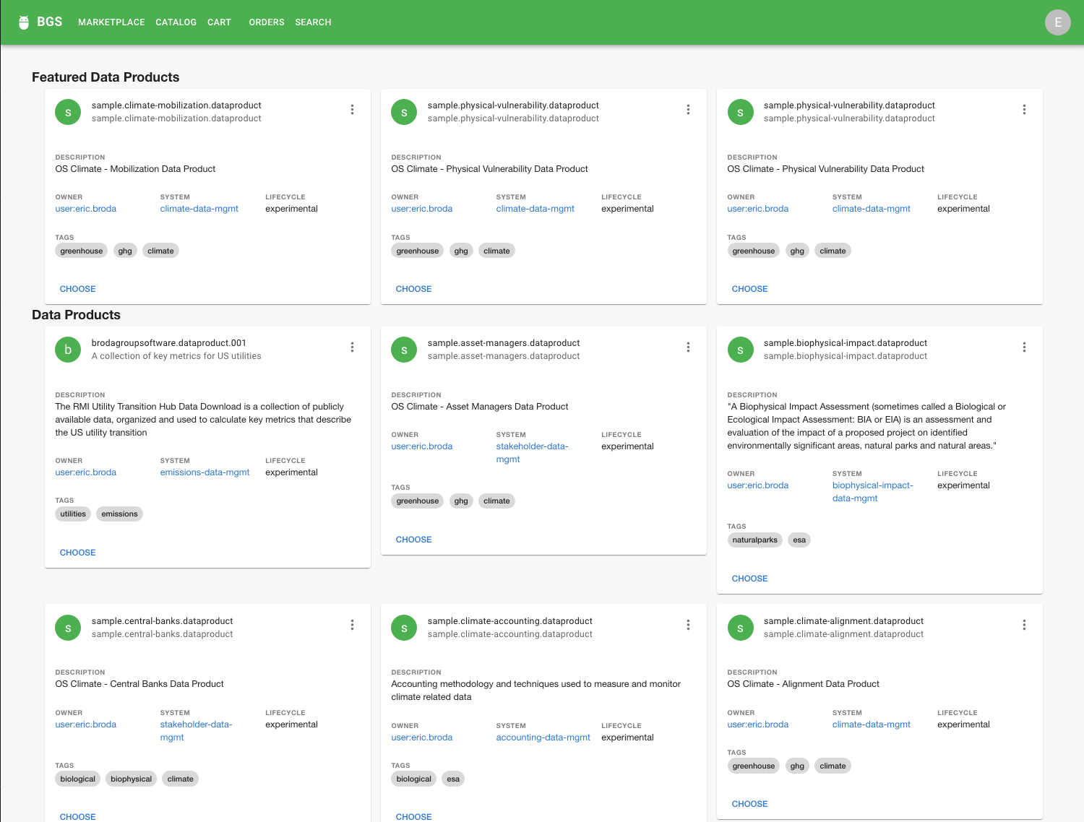
[Marketplace]
The Marketplace provides a one-stop shop to find climate data

Slide 3
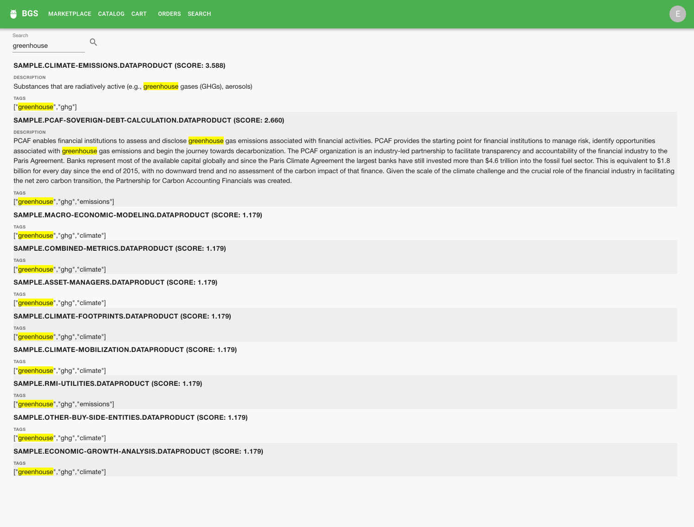
[Data Product Search]
A user may search the marketplace using a query term or phrase – data products that match the search criteria are listed with highlighted terms (note: we use a “fuzzy search” algorithm, and soon OpenAI natural language for search)

Slide 4
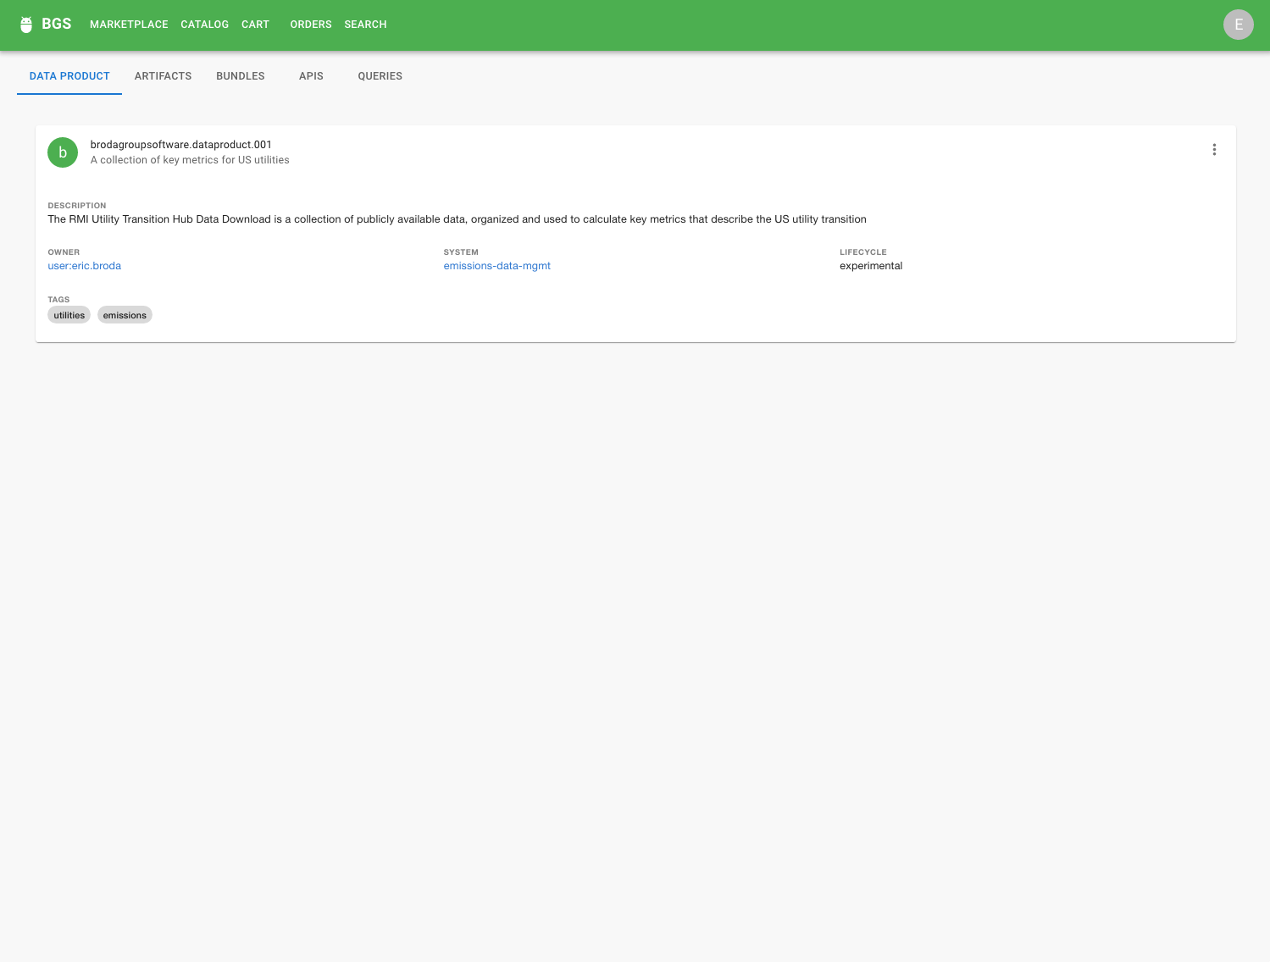
[Data Product View]
Once a data product is found and selected, a Data Product View provides a summary of a climate data product, while offering new tabs to further examine a data product

Slide 5
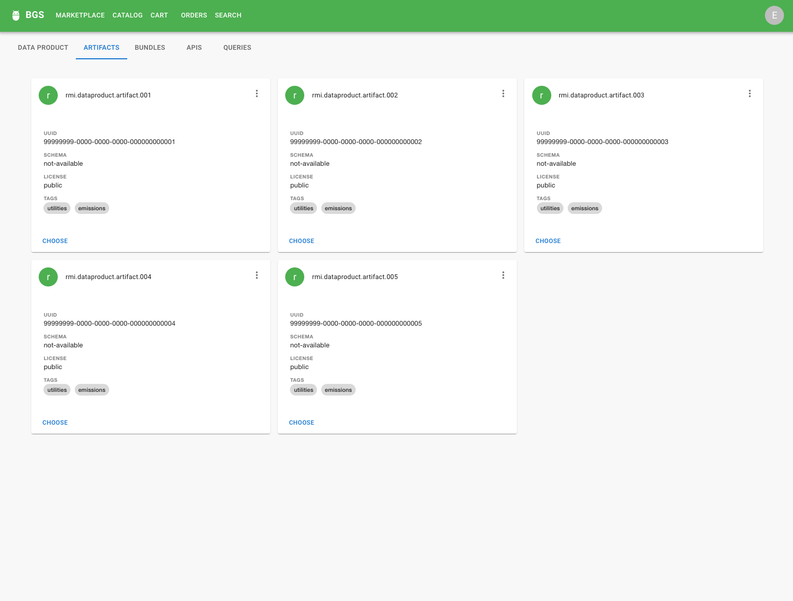
[Data Product Artifacts View]
The Data Product Artifacts view lists all artifacts available by this data product – note that an artifact can be a file, data set, database, or program, AI model (literally, anything the data product owner wishes to publish)

Slide 6
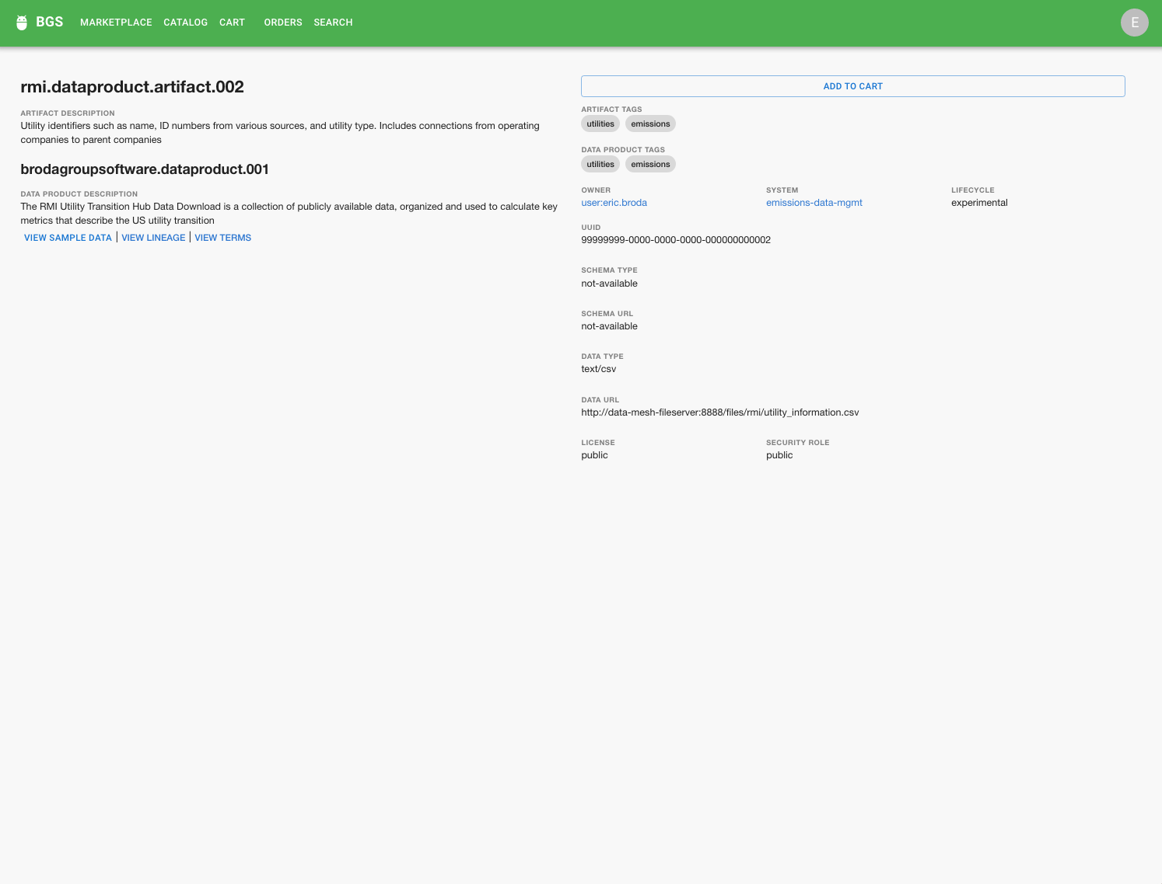
[Data Artifact View]
The Data Artifact View provides the detailed information for a specific artifact while allowing the user to “purchase” (ie. request) the artifact

Slide 7
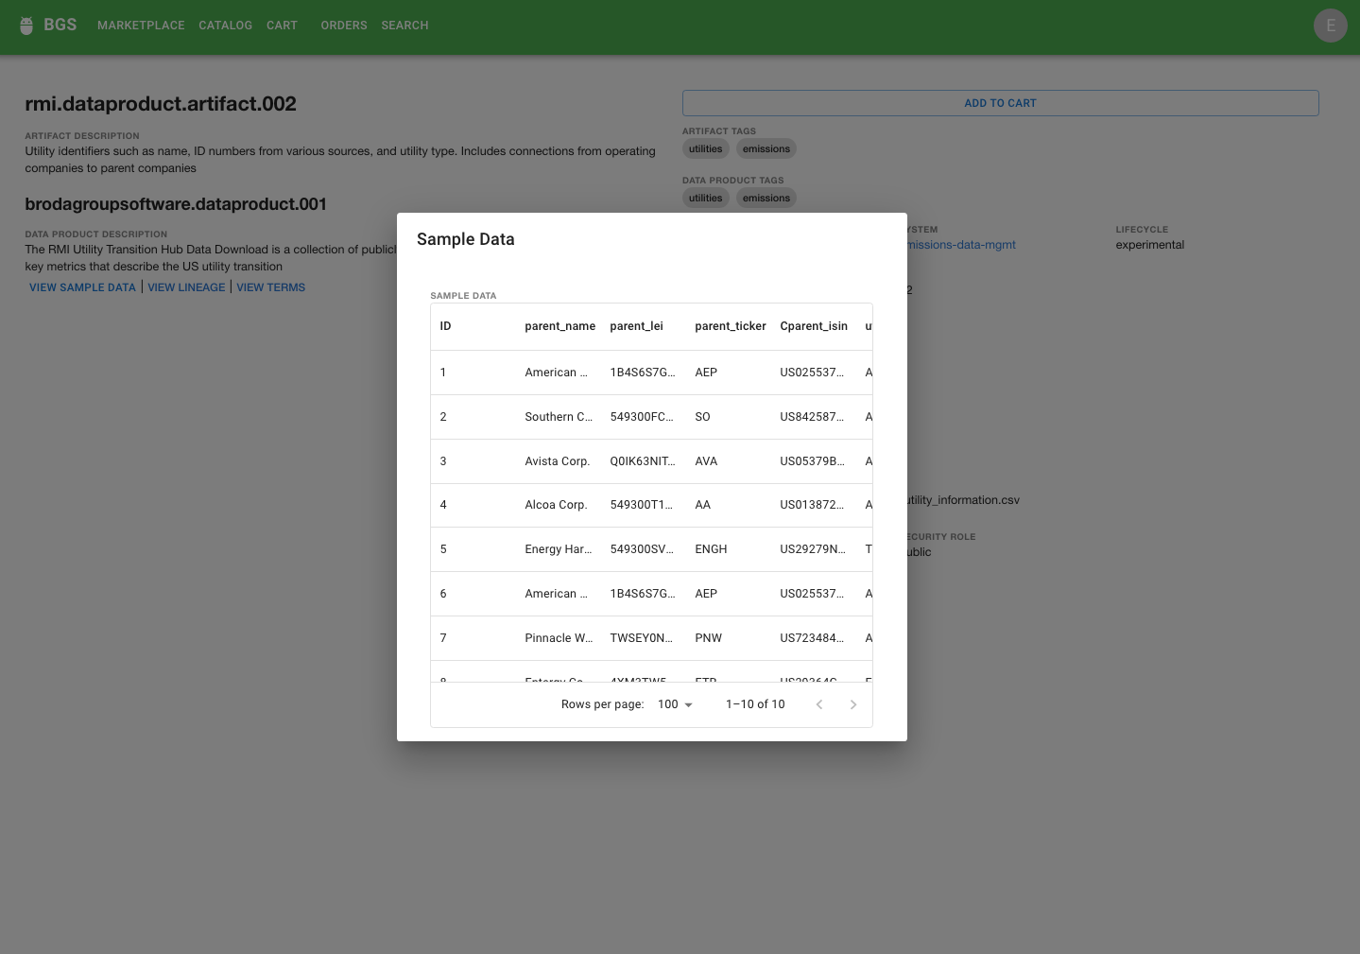
[Data Product Sample Data View]
Each data product provides supplementary data including sample data

Slide 8
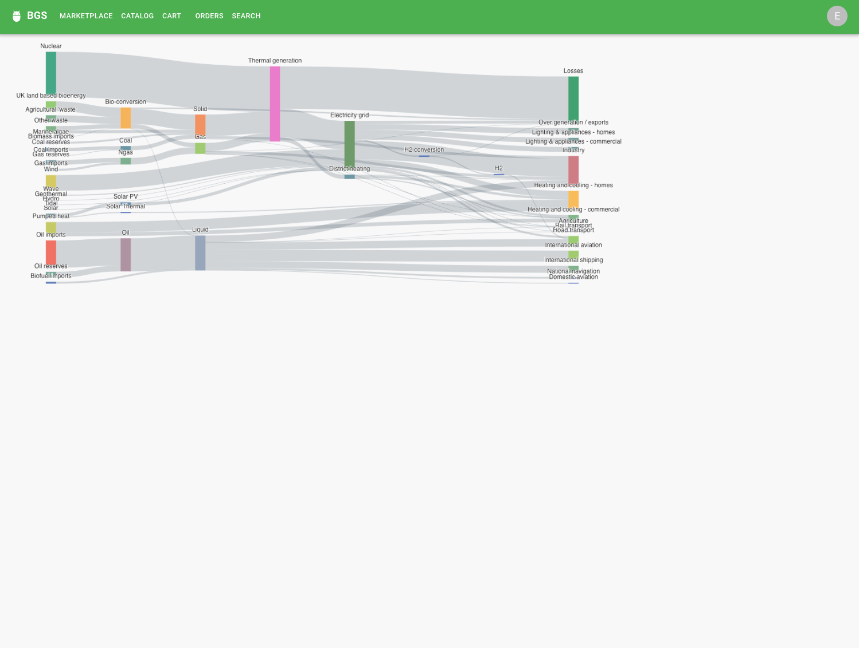
[Data Product Provenance View]
Data Products interact in a global ecosystem of climate data – in the Data Exchange, each data product tracks lineage which, when combined, provide a broad set of provenance data required to provide trust in climate data

Slide 9
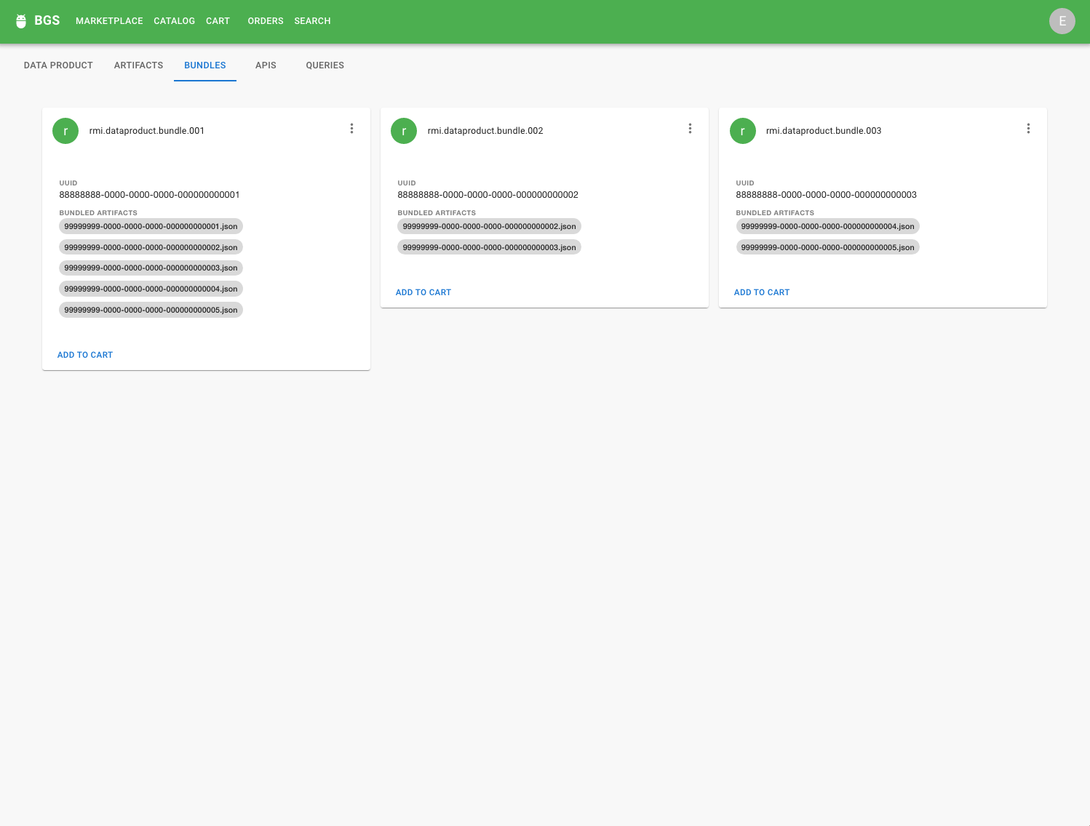
[Data Bundles View]
A data product owner can group related artifacts, or those that work together (several data sets plus a Jupyter Notebook to process them) into bundles – a bundle can be “purchased” as a group

Slide 10
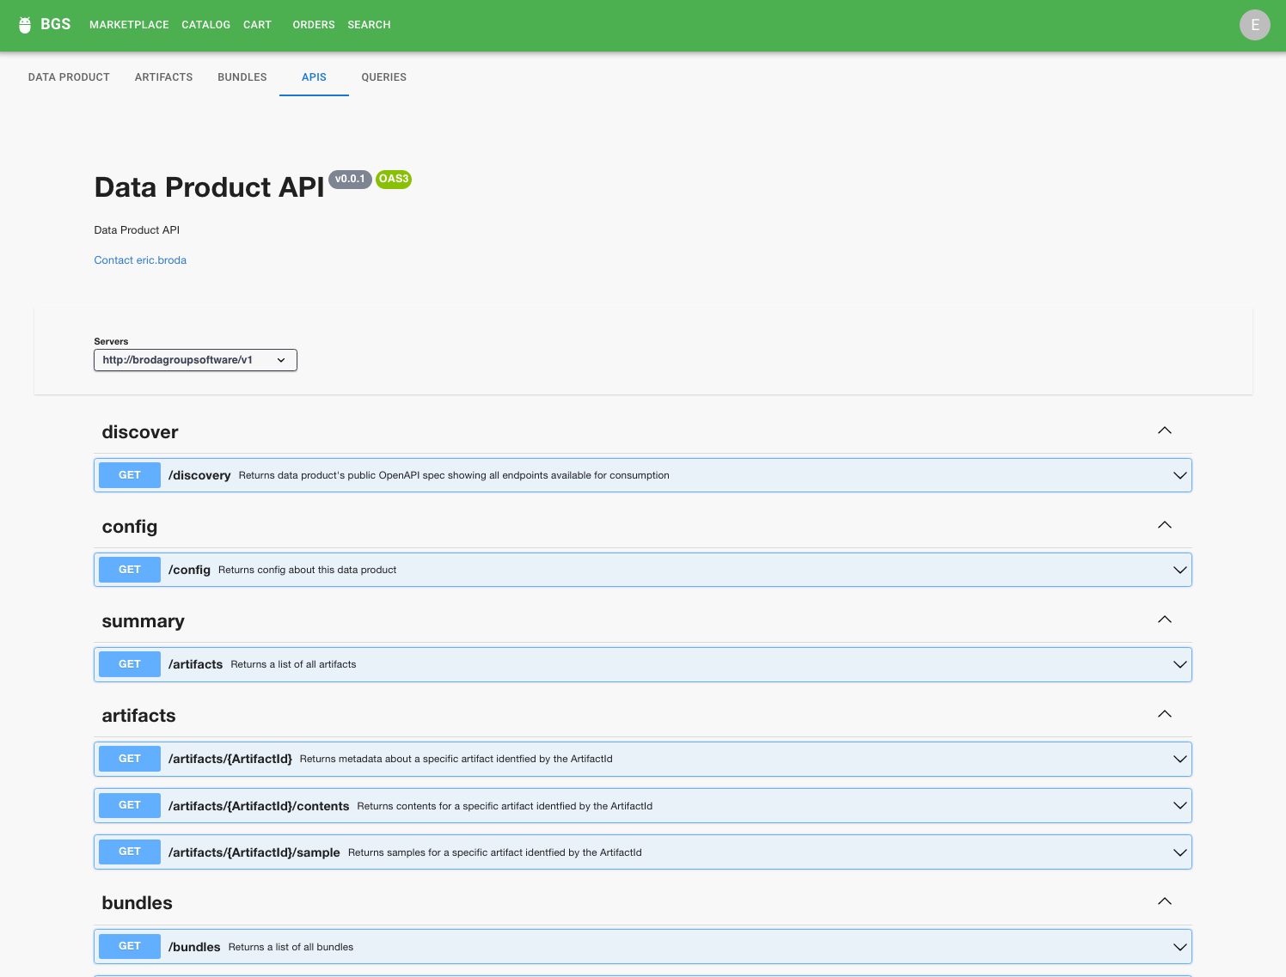
[Data Product API View]
Each data product can be accessed view the Data Exchange UX as well as from a set of published APIs – these APIs allow consumers and publishers to consume/use data products programatically

Slide 11
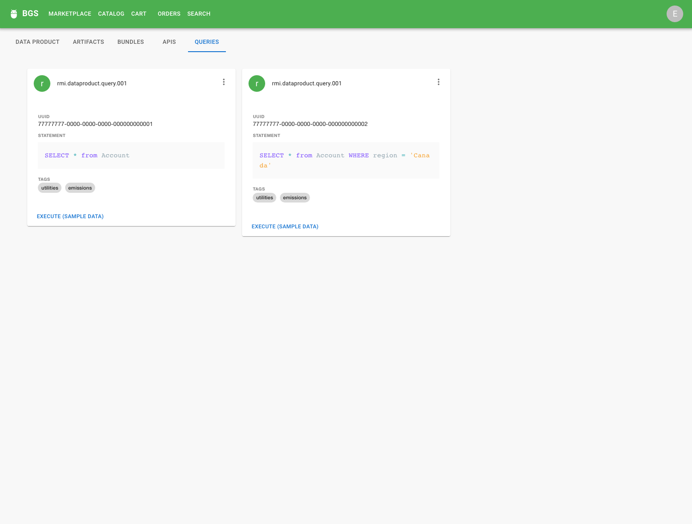
[Data Product Query View]
Some data products may be accessible via federated queries (for example, via Trino) – curated queries can also be made available in a climate data product

